Slide 1

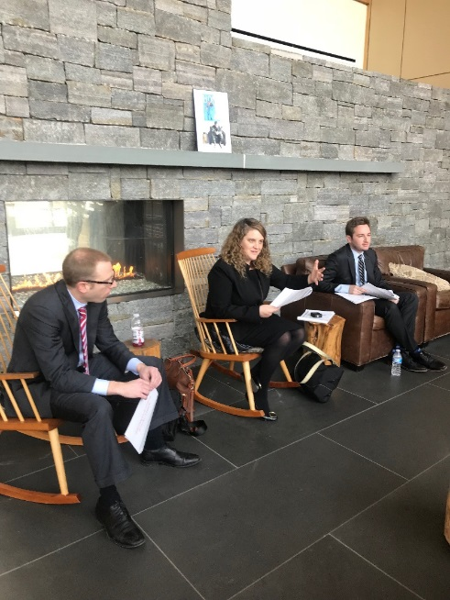
Know Your Rights and Responsibilities
Avoid Missing Out on a Military Medical Retirement
Rochelle Bobroff, Director of Pro Bono Program
Esther Leibfarth, Senior Staff Attorney
David Sonenshine, Senior Staff Attorney

Slide 2

Agenda
Overview of National Veterans Legal Services Program (NVLSP) and Lawyers Serving Warriors® (LSW) program
Integrated Disability Evaluation System
IDES Quicktips
Boards for Correction of Military/Naval
Records
Combat-Related Special Compensation

Slide 3
NVLSP: Who Are We?
National Veterans Legal Services Program (NVLSP) is a nonprofit organization formed in 1981. We work to ensure that our nation’s disabled veterans and active duty personnel receive the benefits to which they are entitled.
What We Do:
  Individual Attorney Representation and Class Action Lawsuits
  Training & Mentoring of Veterans Advocates
  Publication of Training Materials- Including the Veterans Benefits Manual
  Lawyers Serving Warriors®

Slide 4
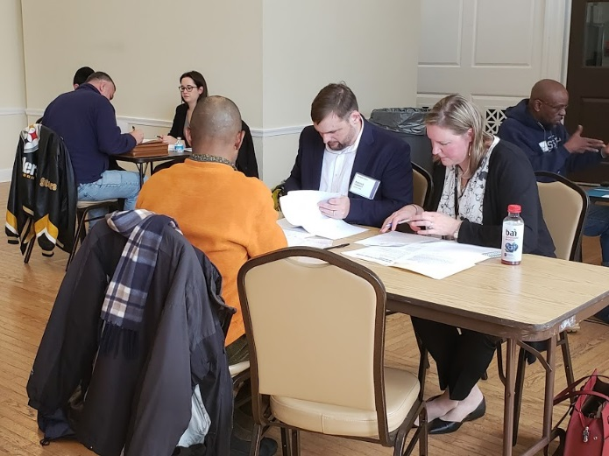
Lawyers Serving Warriors® (LSW)
  Lawyers Serving Warriors is NVLSP’s pro bono project.
  Provides free legal assistance through a network of volunteer attorneys to veterans of all eras with various military disability issues.
  NVLSP attorneys serve as mentors and subject matter expert for the volunteer attorneys.

Slide 5
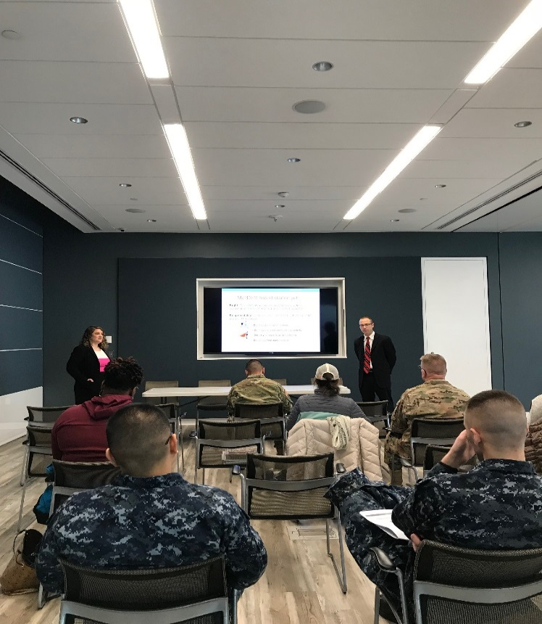
How LSW Helps Service Members
  Clinics on military installations
    “Know Your Rights”
    Individual counseling.
  MEB/PEB representation
  Dual processing administrative separation cases
    Service member’s disability caused or contributed to the misconduct

Slide 6
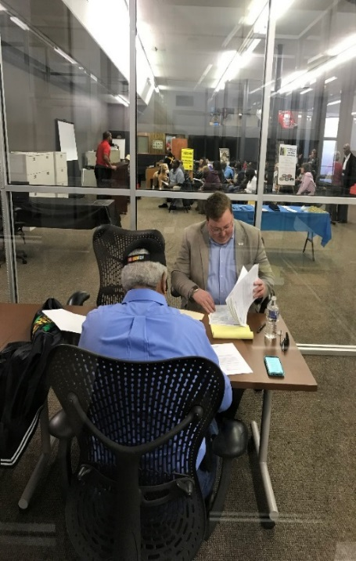
How LSW Helps Veterans – DoD
  Medical Retirements
    Board for Correction of Military Records (BCMR)/ Board for Correction of Naval Records (BCNR)/ Physical Disability Board of Review
    Integrated Disability Evaluation System (IDES)
    Court of Federal Claims and/or District Court
  Combat-Related Special Compensation
    Initial applications and reconsideration
    BCMR/BCNR
    Court of Federal Claims and/or District Court
  Discharge Upgrades:
    Discharge Review Board (DRB)
    BCMR/BCNR
    District Court

Slide 7
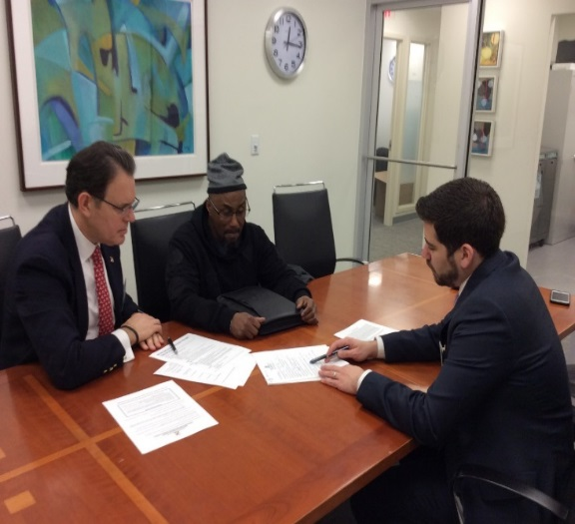
How LSW Helps Veterans – VA
  Program for Military Sexual Trauma (MST) Survivors
    Initial VA Benefit applications and appeals for survivors of Military Sexual Trauma (MST)
  Appeals of VA Benefits Denials – All Conditions
    US Court of Appeals for Veterans Claims (CAVC) and remands to the Board of Veterans’ Appeals (BVA)
  Complex legal matters before the VA
    VA Caregiver Program appeals.

Slide 8
Our Contact Info for Free Legal Services
Website:
https://www.nvlsp.org/what-we-do/lawyers-serving-warriors/
Phone:
202.265.8305, ext. 152
E-mail:
info@nvlsp.org

Slide 9
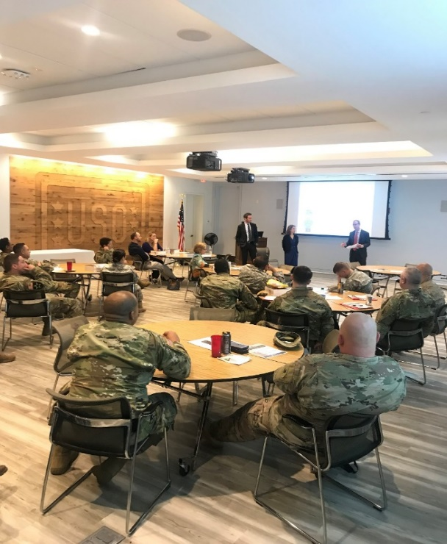
Military Disability Retirement Through
The Integrated Disability Evaluation System

Slide 10
What is a Medical Retirement?
Medical Retirement is issued when a service-connected medical condition(s) is severe enough to interfere with the proper performance of one’s military duties and that injury(s) is rated at 30% or more by the VA.
Medical retirement compensation is different from VA disability compensation:
  Medical retirement compensates ONLY for conditions that bring about the end of one’s service.
  VA disability compensation is intended to compensate for all service-connected disabilities that interfere with civilian employment, but do not necessarily bring about the end of one’s military service.

Slide 11
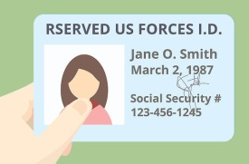


Benefits of a Medical Retirement
A medical retirement bestows the same benefits given to Service members who serve 20+ years in the military, including:
  Military healthcare (TRICARE) for the veteran, his or her spouse, and his or her children until the age of 18.
  A monthly payment (that equates to the veteran’s disability).
  A retired military ID card to get onto military installations.

Slide 12
How to Obtain a Medical Retirement
In Service:
  Integrated Disability Evaluation System (IDES).
Post–Discharge:
  Board for Correction of Military Records (BCMR).
  Physical Disability Board of Review (PDBR), only where service member was medically-separated from the U.S. military between September 11, 2001 and December 31, 2009.
  U.S. Court of Federal Claims or District Court.

Slide 13
IDES
The Integrated Disability Evaluation System (IDES) is the joint DoD-VA process by which DoD determines whether Wounded, Ill, or Injured (WII) service members are fit for continued military service.
IDES Includes:
  VA examinations: for all referred and claimed conditions.
  A Medical Evaluation Board (MEB): DoD medical professionals who document a service member’s medical status and evaluate whether a Service member’s conditions meet/fail the Service branch’s retention standards.
  A Physical Evaluation Board: DoD board comprised of officers and physicians who determine whether a service member is FIT/UNFIT for duty.
  Ratings: If a service member is found unfit for any condition, he or she will receive VA ratings for ALL claimed conditions. The DoD will adopt the VA rating for all unfitting conditions.

Slide 14
Criteria for Determining Fitness/Unfitness for Military Service
Unable to perform the duties of his or her office, grade, rank, or rating.
The medical condition imposes unreasonable requirements on the military to maintain or protect the service member.
A service member can be considered unfit due to the overall effect of two or more impairments (Combined Effect).

Slide 15
What Makes a Condition “Unfitting”
  A Condition is Unfitting:
    Prevents a SM from performing the requirements of his MOS, his basic soldiering duties, and/or alternative APFT.
    Places an unreasonable burden/risk on the Army and/or the SM.
  Proving a Condition is Unfitting:
    Profile
    Medical notes
    Commander’s statement
    Buddy statements

Slide 16
Medical Retirement vs. Separation
Retirement
Tricare for SM & family.
DoD retired ID.
Severance
One time cash infusion.
VA disability payments.
Possibility of CRSC.
Higher of VA/DoD monthly payments.
VA care for SM for service-connected conditions.
Eligible to apply for CRSC.

Slide 17
IDES Quick Tips

Slide 18


My IDES hasn’t started yet …
Define Desired Outcome: You can’t support FITNESS & UNFITNESS at the same time.

Slide 19

My IDES hasn’t started yet …
Right: To have the VA, MEB and PEB review ALL service-connected conditions regardless if they are cause for referral.
Responsibility: Assemble a list of all your service-connected conditions for your VA form 21-0819 when meeting with your VA Military Service Coordinator (MSC).
TIP: Request your medical records from your PEBLO and/or the Records Department to review PRIOR to your meeting with your MSC.

Slide 20
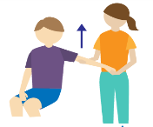

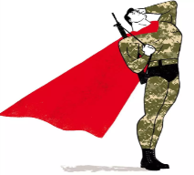

My IDES hasn’t started yet …
Right: To a VA Compensation and Pension (C&P) examination for each referred and claimed condition.
Responsibility: To punctually attend ALL scheduled C&P exams. This Means:
- Don’t refuse range of motions.
    - Don’t over or under perform intentionally.
    - Don’t try to “suck it up” at the exams.
    - Don’t miss your appointments.

Slide 21
My IDES hasn’t started yet …
Right: Right to seek counsel, military and/or civilian (at own expense).
TIP: NVLSP provides civilian assistance free of charge!
Responsibility: Reach out/Communicate with Counsel
Don’t wait! Schedule an initial meeting with your selected counsel as soon as your IDES process starts.
Provide counsel with releases to obtain all medical records.
Let counsel know of any responses from the MEB/PEB.
Obtain supporting documents requested by counsel.

Slide 22
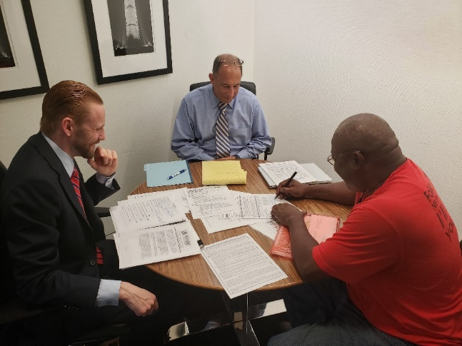
I’m at the MEB …
Right: To have the MEB document all medical condition(s) and your entire medical history as part of narrative summary (NARSUM).
Responsibility: Review the NARSUM and ensure it addresses all conditions and symptoms. No one, including your PEBLO and/or attorney, knows your medical history as well as you.

Slide 23
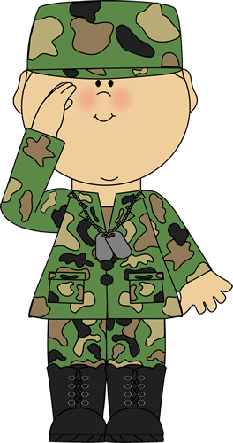
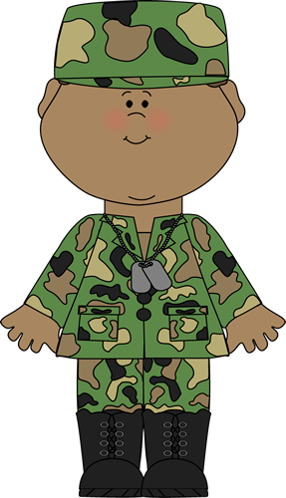
I’m at the MEB …
Does the diagnosis/NARSUM address the body part affected and all your symptoms?
Diagnoses:
My NARSUM is missing facts.
The VA and/or DoD’s diagnoses are wrong
NO
YES
Appeal with evidence of a different diagnosis by a medical professional.
An appeal may not be necessary as ratings are not based on diagnoses but on body part effected and the severity of symptoms.

Slide 24
I’m at the MEB …
Right: To have the military consider each VA diagnosis as a potentially medically unacceptable/duty limiting condition.
Responsibility: Having a diagnosis does not make a condition medically unacceptable/duty limiting. Obtain documentation from a medical provider and/or command that shows condition prevents your further service.
TIP: Consider whether you are at a medical retention determination point, have been provided optimal treatment, and/or whether your condition interferes with service.

Slide 25
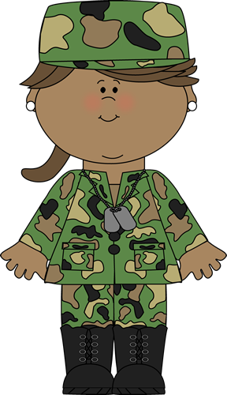
I’m at the MEB …
Documentation:
My doctor/commander won’t provide the documentation I need to support my appeal.
  There is no way to require your commander/NCO/doctor to provide documentation.
  If, you think there is a basis for the documentation, get a second medical opinion and/or reach out to another senior officer/NCO.

Slide 26
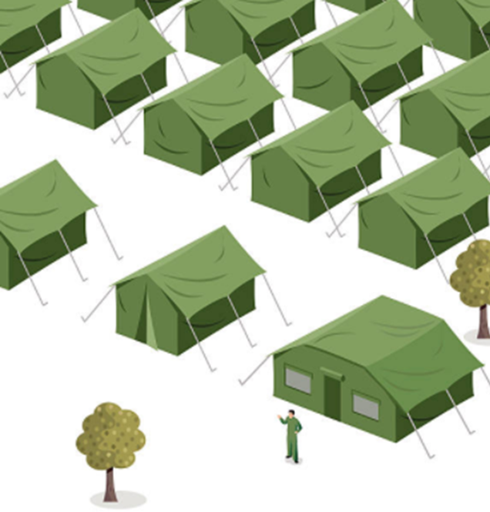
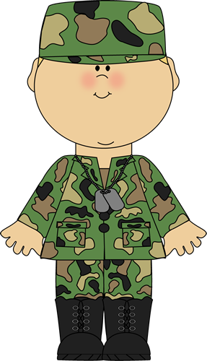

I’m at the PEB …
The Barracks Laywer
  Identical conditions can
  have different effects.
  The PEB is all about the effect
  of your condition on your military
  duties.
  Fitness depends on MOS,
  rank and symptoms, not just diagnosis.
My friend has the same condition and it is unfitting, why isn’t my condition?

Slide 27

I’m at the PEB …
GET LEGAL ADVICE:
Reach out to your attorney IMMEDIATELY to get legal advice and help preparing a written appeal or for a formal hearing.
I disagree with the PEB findings, what should I do?

Slide 28
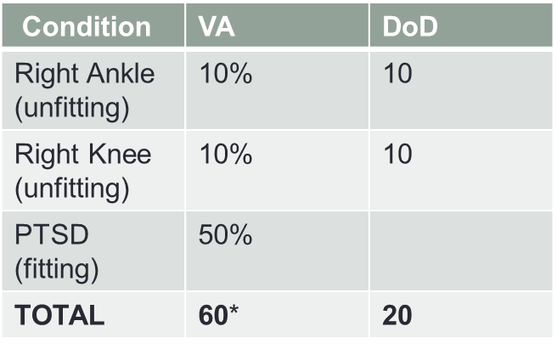
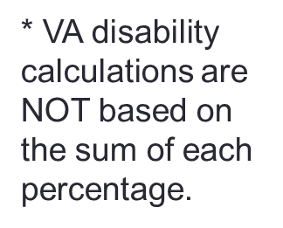
I’m at the PEB …
VA vs. DoD RATINGS:
The VA rates any condition incurred or permanently aggravated by service with symptomology.
The DoD applies the VA ratings for UNFITTING conditions.
Why is my combined VA rating so much higher than my DoD rating?

Slide 29
I’m at the PEB …
Right: To have the VA reconsider your unfitting condition(s) one time while still in service.
Responsibility: Contact your attorney with any/all supporting documents to draft a VA Ratings Reconsideration (VARR).
TIP: Get new Range of Motion (ROM) done as soon as you think the VA ROM was inaccurate.

Slide 30
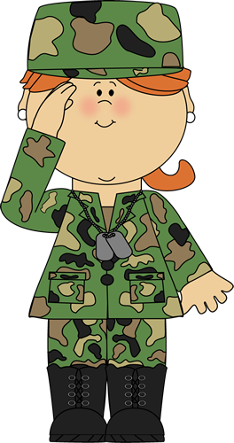
I’m at the PEB …
What is TDRL?
  TDRL: Temporary Disability Retirement List and it occurs when an SM has a condition (mental or physical) that may get better or worse over the next 3 years.
  Condition that almost always requires TDRL: PTSD.
    Avoidable?: Only if medical evidence shows that it is stable for rating purposes.
Can I avoid it?

Slide 31
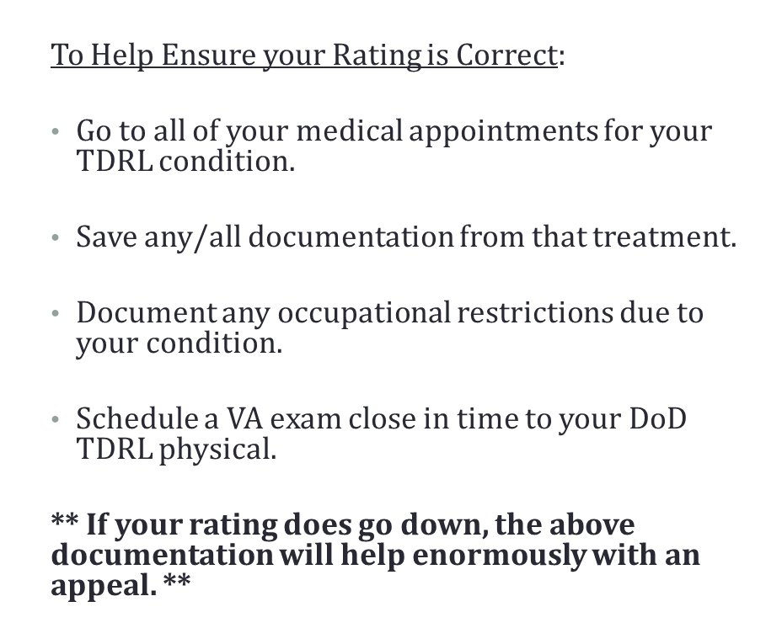
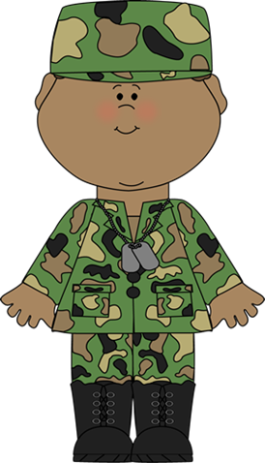
I’m on the Temporary Disability Retirement List (TDRL) …
I am on the TDRL and I worried my rating will go down.

Slide 32
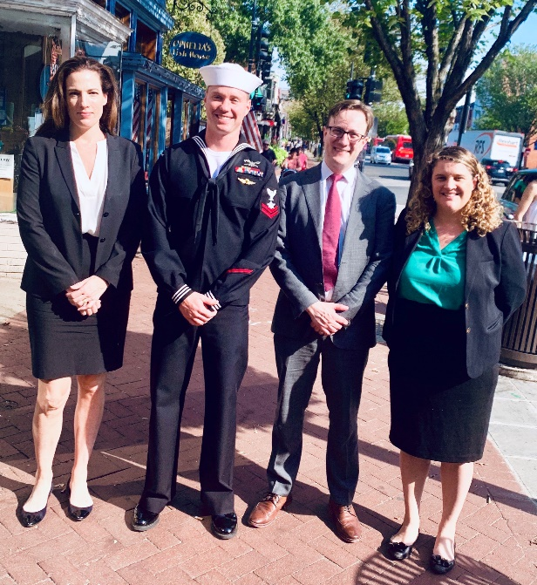
PEB Success Story
A Special Warfare Combatant-Craft Crewman incurred a TBI when his craft experienced a bow plunge at 50 miles per hour off the coast of Iran, submerging him and the craft underwater. The Informal PEB found him FIT despite the fact that the dizziness, migraines and vertigo caused by his TBI left him unable to return to a SWCC boat or to work more than 24 hours a week in any capacity.
NVLSP and pro bono counsel represented him before the Formal PEB. He was found unfit for TBI with vertigo of central origin and migraines. His injury was found to be combat related.

Slide 33
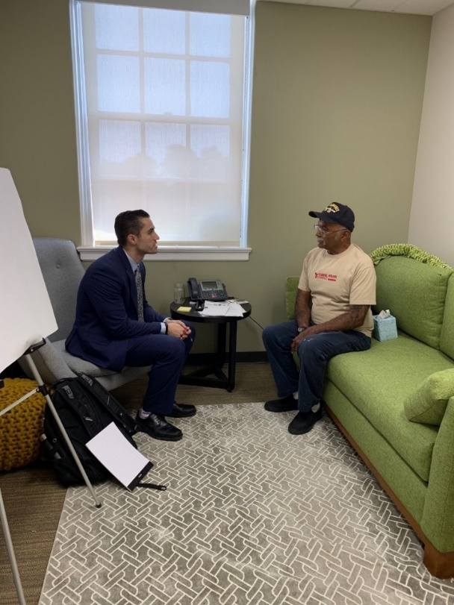
Boards for Correction of Military/Naval Records

Slide 34
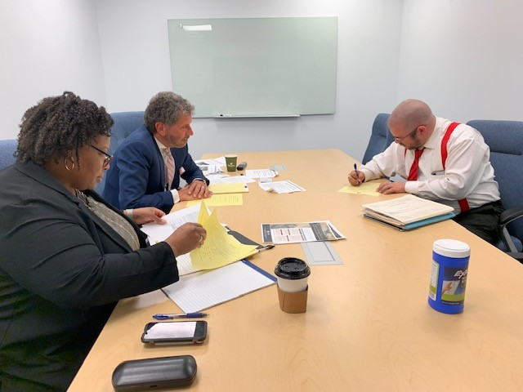
Post-Discharge Relief:
Boards for Correction of Military Records
Each military branch has a BCMR/BCNR where veterans who did not obtain a medical retirement in the IDES process can submit an application for medical retirement.

Slide 35
Post-Discharge Relief:
Boards for Correction of Military Records (BCMR/BCNR)
Veteran WAS provided Disability Evaluation System (DES) processing, but:
  The PEB fails to identify all unfitting conditions or fails to provide the correct disability rating, resulting in service member’s separation with severance payment.
Veteran WAS NOT provided Disability Evaluation System processing and was separated with injuries because:
  Fulfilled his/her service obligation
  Injuries caused misconduct that resulted in administrative separation
  Military wrongly determines the service member’s injury is not a compensable condition.

Slide 36
Post-Discharge Relief:
Boards for Correction of Military Records (BCMR/BCNR)
Reviewers: 3 civilians in grade of GS-15 and above review BCMR/BCNR applications.
Review Type: Records review only! Submit copies of all relevant personnel and medical records. The BCMR/BCNR will have your personnel record, but may not have access to all service medical records.
Burden of Proof: Applicants have the burden of proof to establish an error or injustice. The boards presume administrative regularity.
Statute of Limitations: Applicants must file an application within 3 years after an alleged error or injustice is discovered. The BCMR may excuse untimely filing in the interest of justice. 10 U.S.C § 1552.

Slide 37
Applying to the BCMR
Application Form: Complete an application on Department of Defense Form 149, Application for Correction of Military Record Under the Provisions of Title 10, U.S. Code, Section 1552.
Supporting Evidence:
  Commander’s Statement
  MEB narrative summary/MEB report
  Physical Profile/LIMDU/Abbreviated MEB Report
  DoD/VA medical records
  Personal statement/lay statements
  New medical opinion (if applicable)

Slide 38
BCMR Best Practices
There MUST be records showing:
  In-service diagnosis/treatment; and
  Inability/difficulty in-service performing basic military duties and/or the duties of Military Occupational Specialty/Rating/Air Force Specialty Code.
Increased Symptomology After Discharge: The BCMR is only concerned with veteran’s symptoms around the time of discharge.
VA Disability Percentage: It is necessary for the veteran to have a combined 30 percent disability rating within 1 year of discharge. Otherwise, you need an independent medical expert to look at the veteran’s symptoms at discharge and the pertinent rating schedule and estimate the disability percentage.

Slide 39
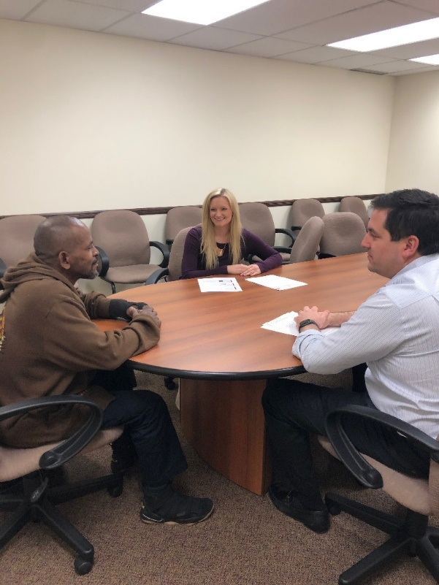
BCMR Success Story
An Army combat veteran suffered from severe Post-Traumatic Stress Disorder (PTSD) due to his exposure to many traumatic events in Iraq including fire fights and mortar attacks.
Pro bono attorneys prepared a brief, gathered medical evidence, and assisted the veteran in submitting an application to the Army Board for Correction of Military Records (ABCMR).
The Board overturned previous decisions and granted the veteran a permanent disability retirement due to his PTSD.

Slide 40
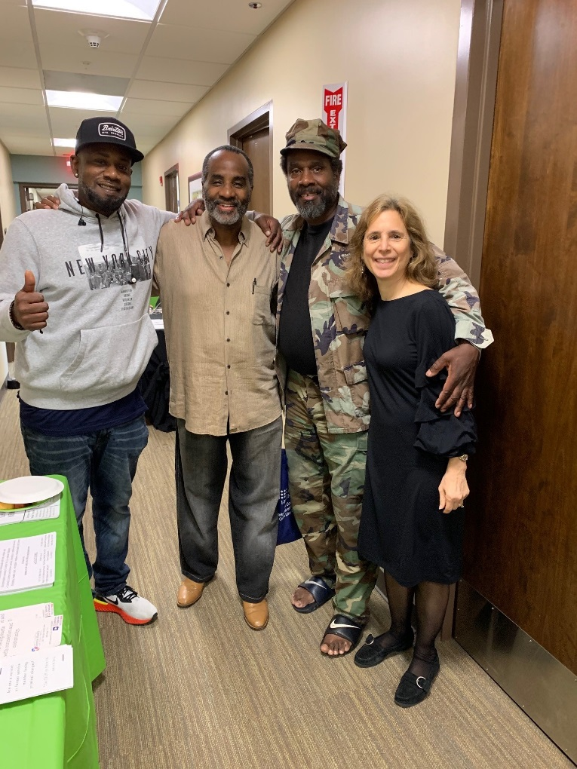
Combat-Related
Special Compensation (CRSC)

Slide 41
What is CRSC?
CRSC is an extra monthly payment provided by the Department of Defense, that is available to eligible veterans who have injuries that are combat-related.
CRSC is a payment that is in addition to any military disability retirement pay and/or VA disability compensation that the veteran may be receiving each month.

Slide 42
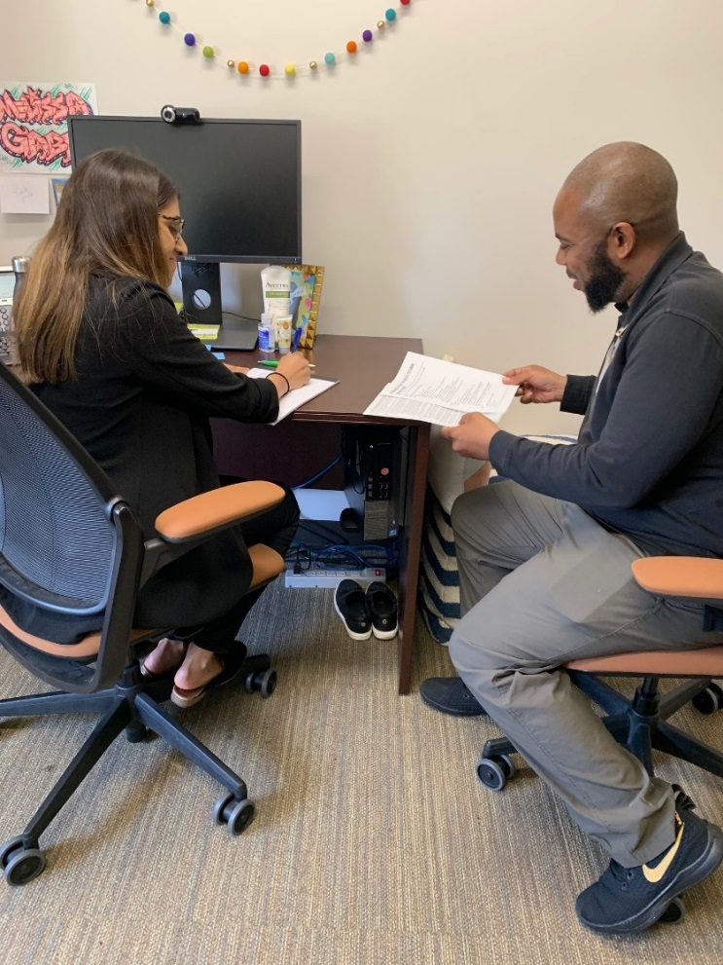
Who is Eligible for CRSC?
The primary eligibility requirement for CRSC is that the individual must have been retired from the military either due to years of service or disability.

Slide 43
What Types of Injuries/Conditions are Eligible for CRSC?
Injuries/conditions that are service-connected by the VA with a disability rating of at least 10%.
Example Veteran
VA service-connected disabilities: PTSD (30%), Back Pain (20%), Tinnitus (10%), Hypertension (0%).

Slide 44
What Makes an Injury/Condition Combat-Related?
1. Injuries incurred as a direct result of armed conflict.
2. Injuries incurred through an instrumentality of war.
3. Injuries incurred in the performance of duty under conditions simulating war.
4. Injuries incurred while engaged in hazardous service.
5. Injuries for which the member was awarded the Purple Heart.

Slide 45
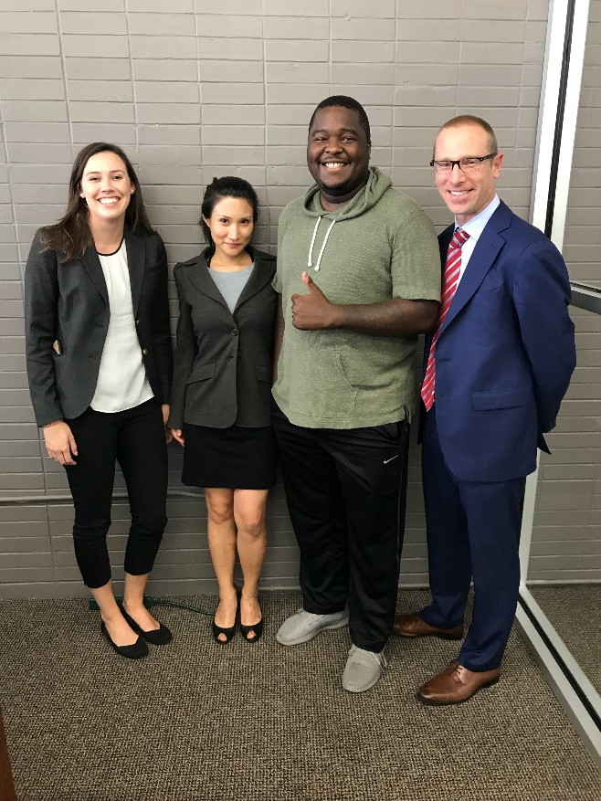
Evidence to Submit in
Support of CRSC Claim
The key to a successful CRSC application is to include all relevant evidence that supports a combat-related determination for each combat-related disability.
Important Documents:
Purple Heart Certificate/Orders
DD Form 214
VA Rating Decisions
PEB Findings
MEB Narrative Summary
Medical Records
Performance Evaluations/Awards
Statements

Slide 46
Applying for CRSC
Complete a CRSC Application (DD Form 2860)
The CRSC Application must be filed with the service branch that retired the veteran.
In addition to the CRSC Application, the applicant should submit any medical records, award citations, lay statements, or any other evidence that supports that an injury was combat-related for CRSC purposes.

Slide 47
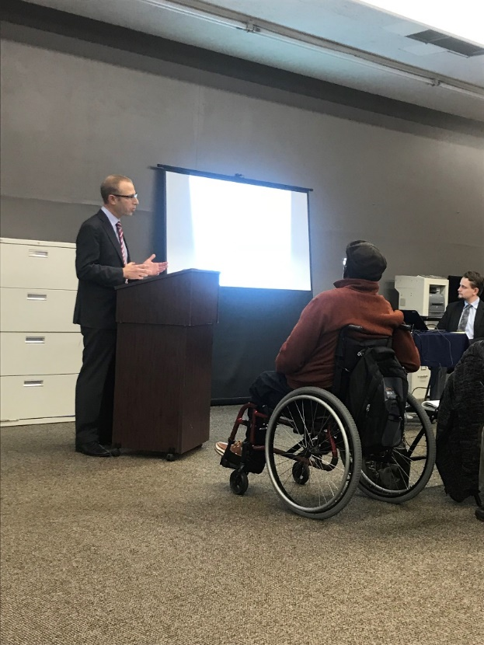
Combat-Related Special Compensation
Success Story
LSW pro bono volunteers represented an Army Staff Sergeant serving in Iraq who injured his back and shoulder falling from an IED blast. He receives approximately $1,000 per month in CRSC and obtained a back award of $17,000.

Slide 48
Our Contact Info for Free Legal Services
Website:
https://www.nvlsp.org/what-we-do/lawyers-serving-warriors/
Phone:
202.265.8305, ext. 152
E-mail:
info@nvlsp.org

Slide 49

Questions

